Slide 1
Steganography
Presented by: Dipesh Tha Shrestha
Presented To: Manoj Gautam

Slide 2
Steganography
Steganography is the art and science of embedding secret messages in a cover message in such a way that no one, apart from the sender and intended recipient, suspects the existence of the message
Steganography is the practice of hiding a secret message inside of (or even on top of) something that is not secret. That something can be just about anything you want.

Slide 3
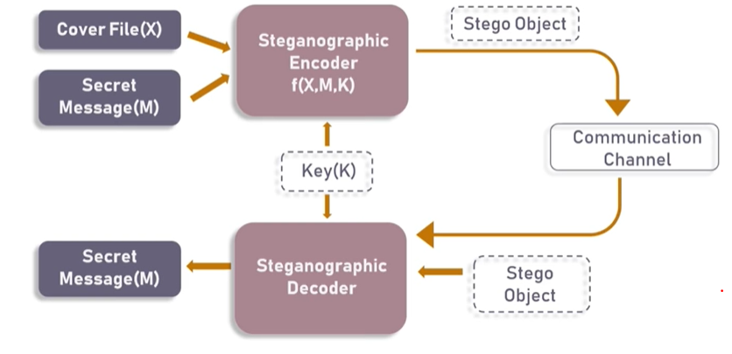
Basic Steganographic Model

Slide 4
Basic Steganographic Model
As seen in the above image, both the original image file(X) and secret message (M) that needs to be hidden are fed into a steganographic encoder as input. Steganographic Encoder function, f(X,M,K) embeds the secret message into a cover image file by using techniques like least significant bit encoding. The resulting stego image looks very similar to your cover image file, with no visible changes. This completes encoding. To retrieve the secret message, stego object is fed into Steganographic Decoder.

Slide 5
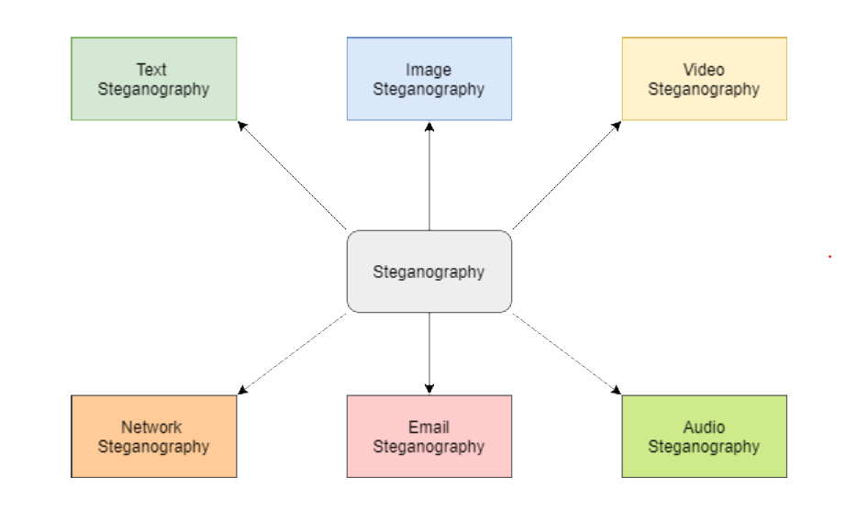
Types of Steganography

Slide 6
Text Steganography
Text Steganography is hiding information inside the text files. It involves things like changing the format of existing text, changing words within a text, generating random character sequences or using context-free grammars to generate readable texts. Various techniques used to hide the data in the text are:
Format Based Method
Random and Statistical Generation
Linguistic Method

Slide 7
Image Steganography
Hiding the data by taking the cover object as the image is known as image steganography. In digital steganography, images are widely used cover source because there are a huge number of bits present in the digital representation of an image. There are a lot of ways to hide information inside an image. Common approaches include:
Least Significant Bit Insertion
Masking and Filtering
Redundant Pattern Encoding
Encrypt and Scatter
Coding and Cosine Transformation

Slide 8
Audio Steganography
In audio steganography, the secret message is embedded into an audio signal which alters the binary sequence of the corresponding audio file. Hiding secret messages in digital sound is a much more difficult process when compared to others, such as Image Steganography. Different methods of audio steganography include:
Least Significant Bit Encoding
Parity Encoding
Phase Coding
Spread Spectrum
This method hides the data in WAV, AU, and even MP3 sound files.

Slide 9
Video Steganography
In Video Steganography you can hide kind of data into digital video format. The advantage of this type is a large amount of data can be hidden inside and the fact that it is a moving stream of images and sounds. You can think of this as the combination of Image Steganography and Audio Steganography. Two main classes of Video Steganography include:
Embedding data in uncompressed raw video and compressing it later
Embedding data directly into the compressed data stream

Slide 10
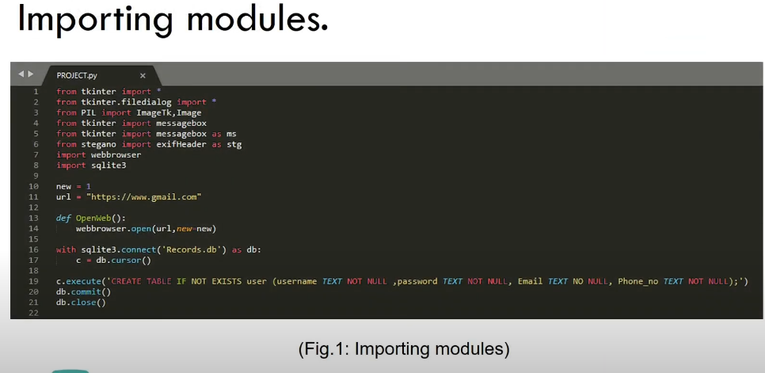
Code of Image Steganography

Slide 11
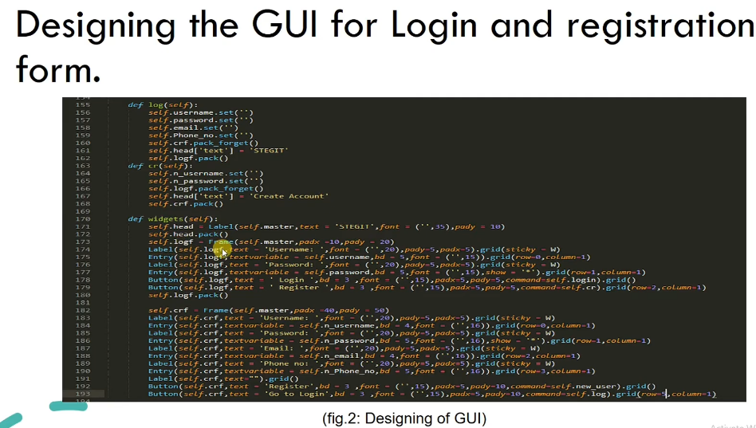

Slide 12
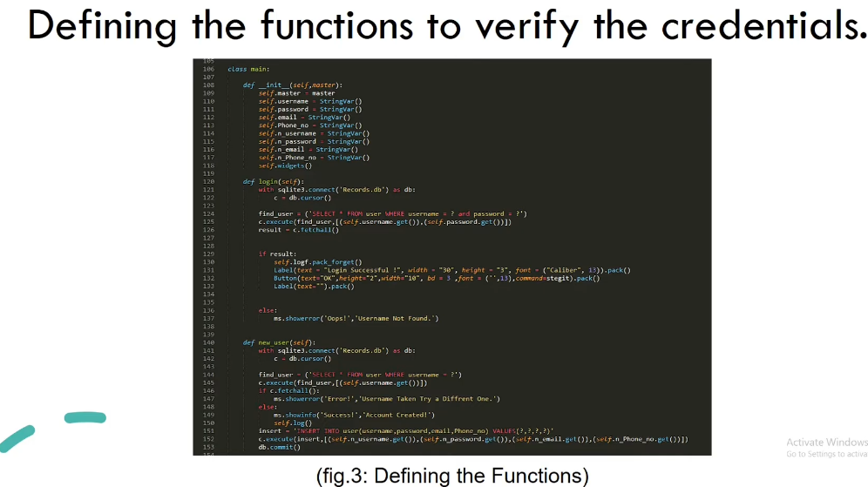

Slide 13
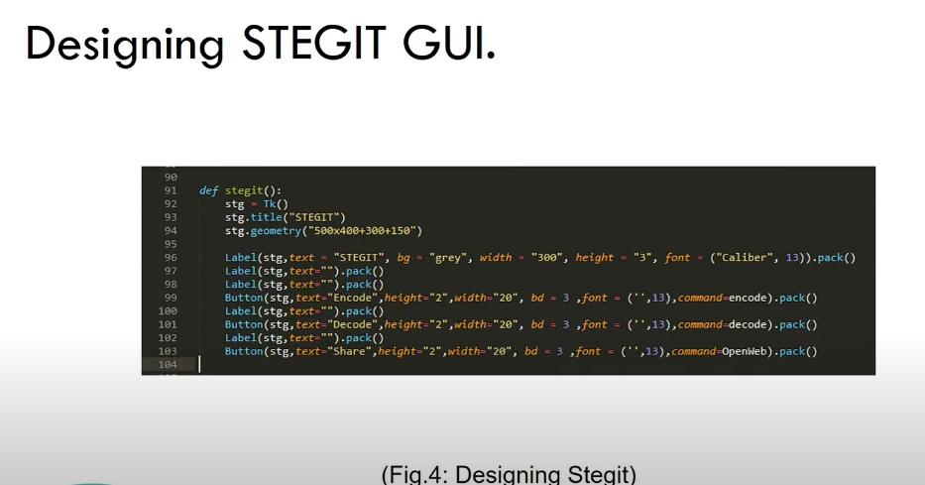

Slide 14
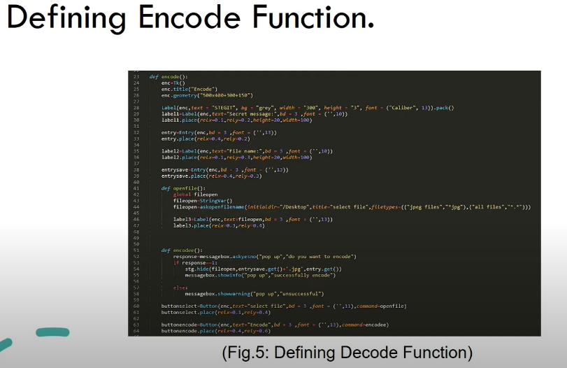

Slide 15
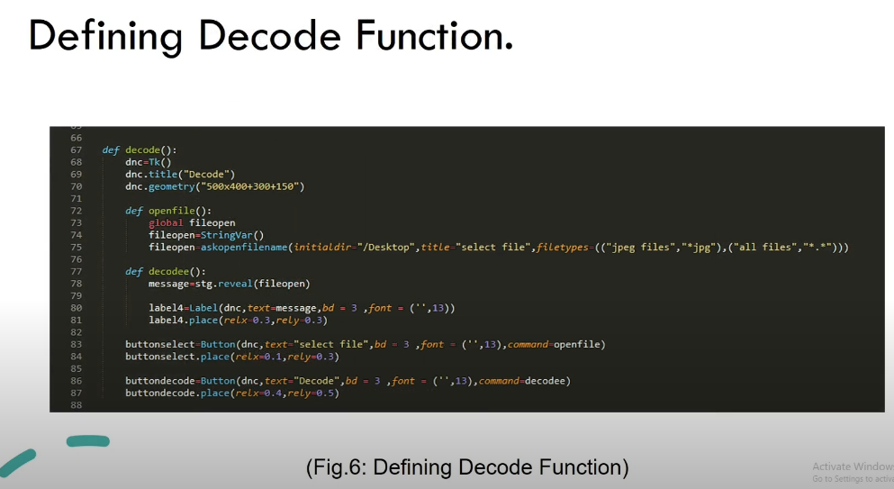

Slide 16
Thank you

